Slide 1




Tracking Political Trends Around US Presidential Election Through Social Media Analysis
Presented By:
Titans
(@kritika_garg, @KumushiniT, @HimarshaJ)
Computer Science Department,
Old Dominion University, Norfolk VA, USA
@WebSciDL, @NirdsLab
CSGS Hackathon, Fall 2024, October 24 – 31, 2024

Slide 2
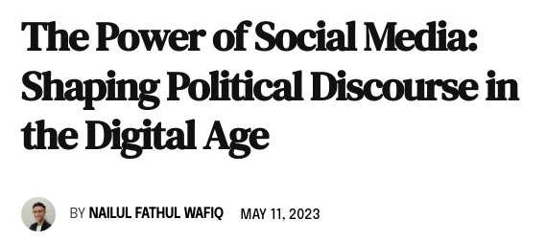
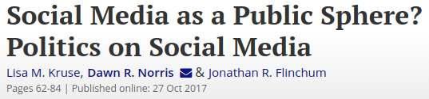
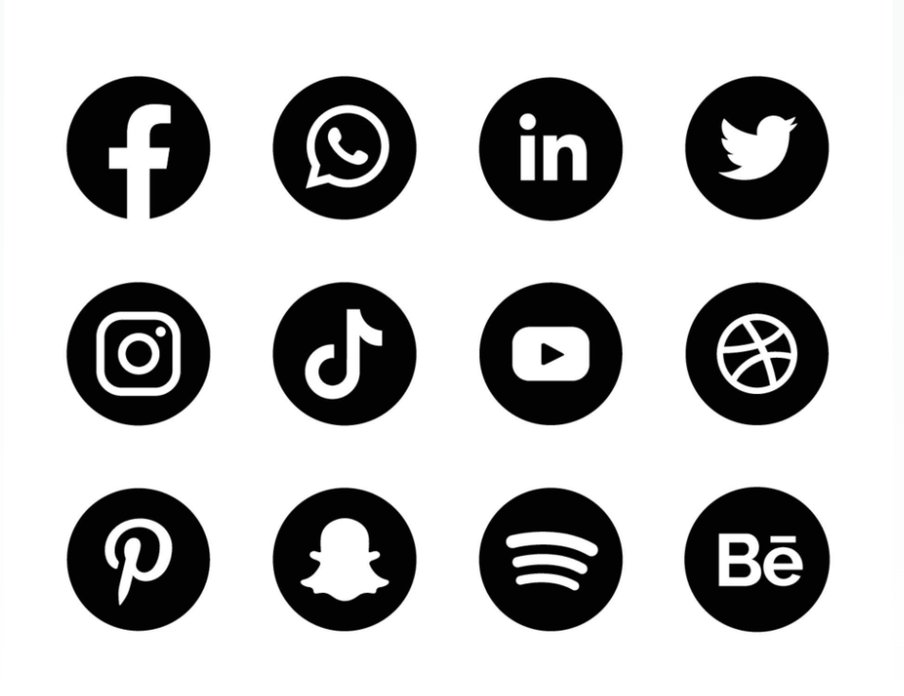
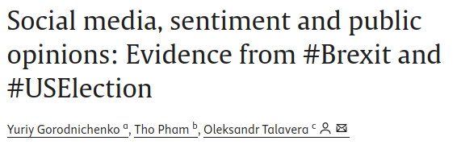
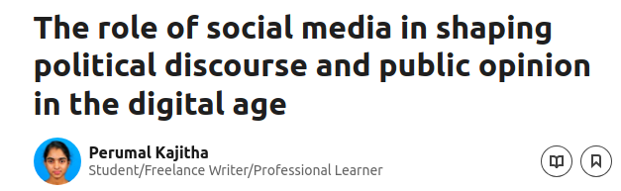
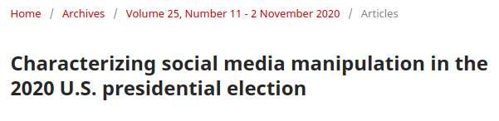
The Role of Social Media in Shaping Public Opinion
https://doi.org/10.1080/00380253.2017.1383143
https://moderndiplomacy.eu/2023/05/11/the-power-of-social-media-shaping-political-discourse-in-the-digital-age/
https://doi.org/10.1016/j.euroecorev.2021.103772
https://www.linkedin.com/pulse/role-social-media-shaping-political-discourse-public-opinion-kajitha/
https://doi.org/10.5210/fm.v25i11.11431

Slide 3
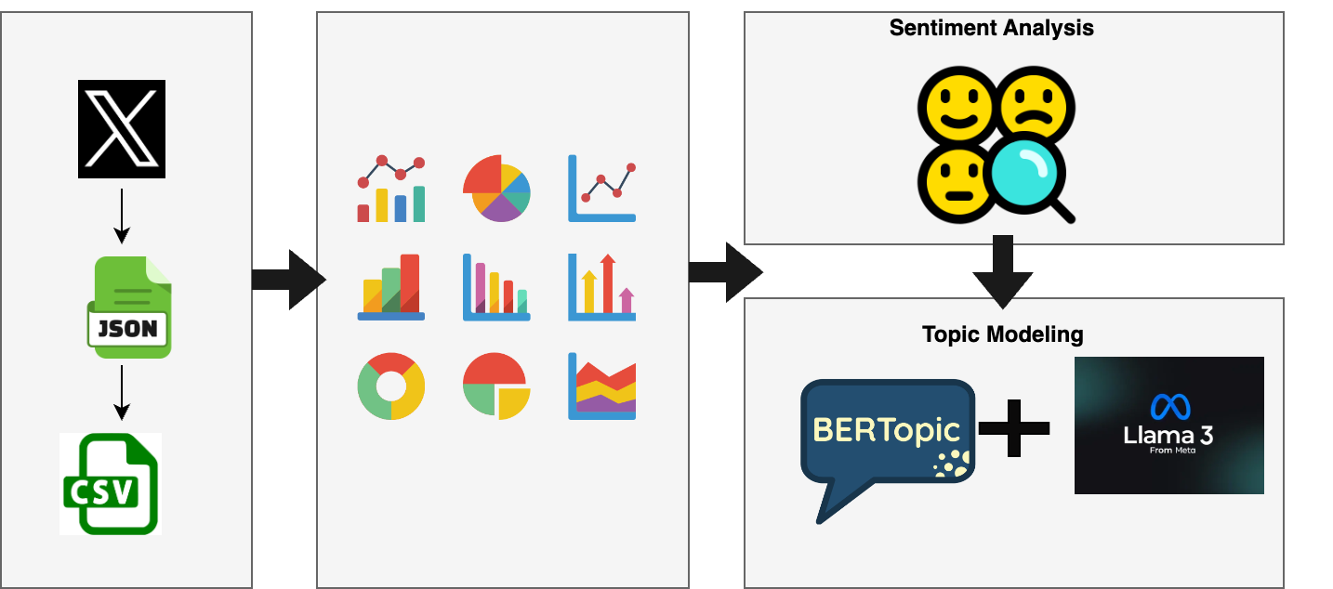
Methodology
Data Collection
EDA
Analysis

Slide 4
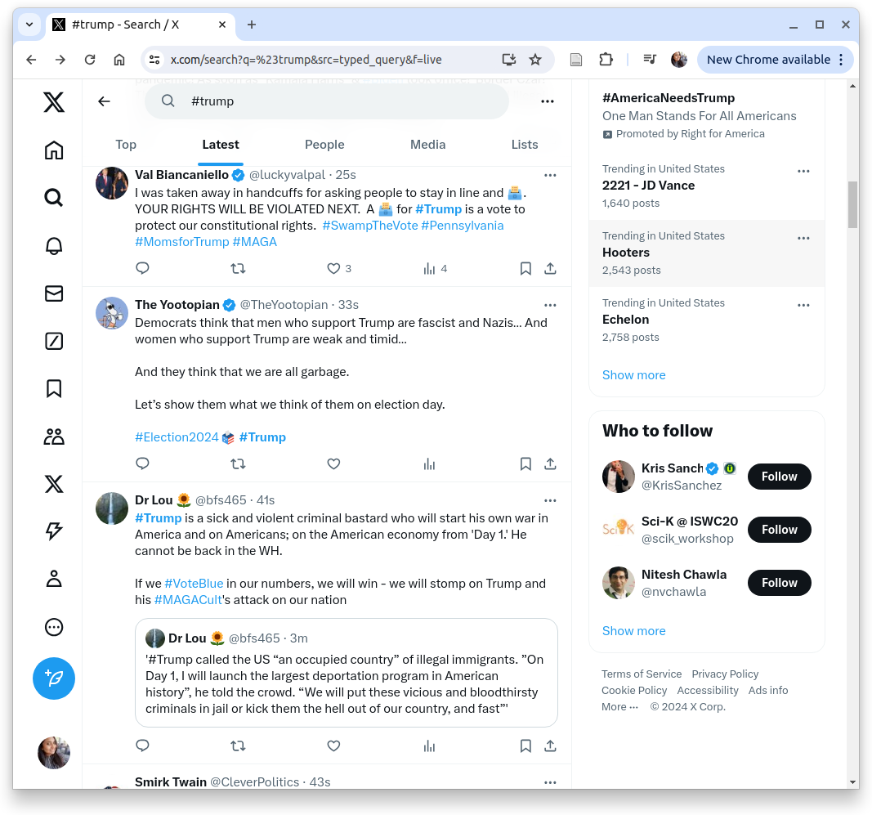

Web Scraping Social Media Site X
{
"content": { ...
"itemContent": { ...
"tweet_results": {
"result": {
"__typename": "Tweet",
"rest_id": "1852069852330234076",
"core": {
"user_results": {
"result": {
"__typename": "User", ....
"legacy": { ...
"screen_name": "luckyvalpal" ... },
"legacy": { ...
"favorite_count": 13,
"favorited": false,
"full_text": "I was taken away in handcuffs for
asking people to stay in line and \uD83D\uDDF3️.
YOUR RIGHTS WILL BE VIOLATED NEXT. A
\uD83D\uDDF3️ for #Trump is a vote to protect our
constitutional rights. #SwampTheVote #Pennsylvania
#MomsforTrump #MAGA",
"is_quote_status": false,
"lang": "en",
"quote_count": 0,
"reply_count": 1,
"retweet_count": 2 ... }
}

Slide 5
Web Scraping Social Media Site X
{
"content": { ...
"itemContent": { ...
"tweet_results": {
"result": {
"__typename": "Tweet",
"rest_id": "1852069852330234076",
"core": {
"user_results": {
"result": {
"__typename": "User", ....
"legacy": { ...
"screen_name": "luckyvalpal" ... },
"legacy": { ...
"favorite_count": 13,
"favorited": false,
"full_text": "I was taken away in handcuffs for
asking people to stay in line and \uD83D\uDDF3️.
YOUR RIGHTS WILL BE VIOLATED NEXT. A
\uD83D\uDDF3️ for #Trump is a vote to protect our
constitutional rights. #SwampTheVote #Pennsylvania
#MomsforTrump #MAGA",
"is_quote_status": false,
"lang": "en",
"quote_count": 0,
"reply_count": 1,
"retweet_count": 2 ... }
}

Slide 6
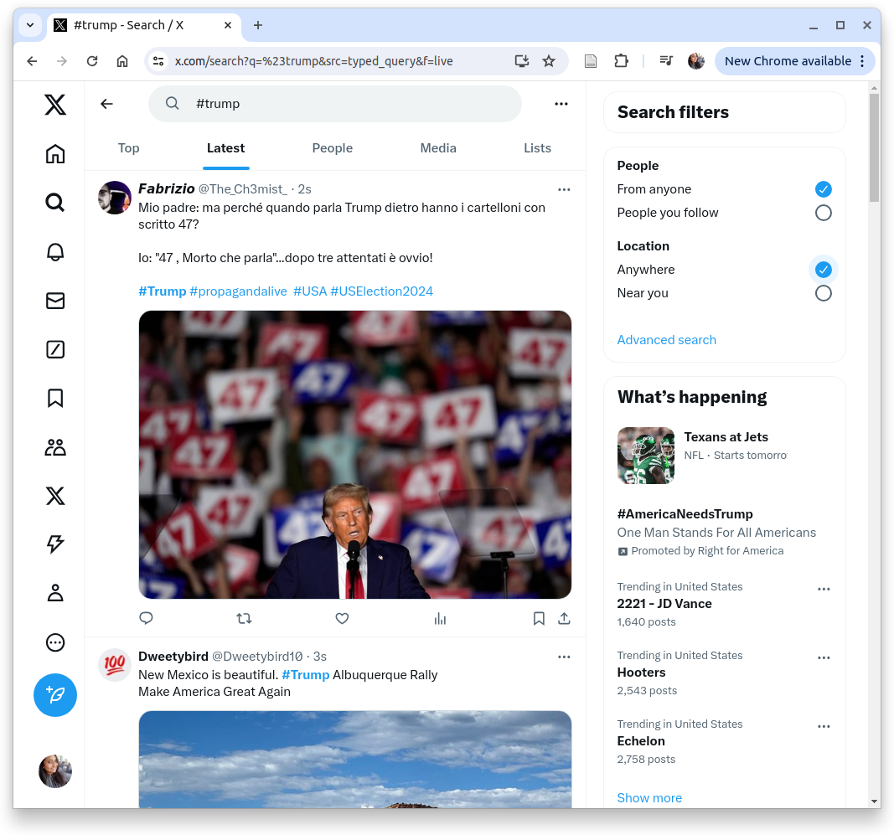
Web Scraping Social Media Site X

Slide 7
Data Collection
Data were collected from X (Formerly known as Twitter)
Time interval for data collection - 2024/10/21 - 2024/10/27
Hashtags used to collect data
#donald
#trump
#kamala
#harris
#presidentialelection
#pennsylvania
#russia
https://ritetag.com/best-hashtags-for/election

Slide 8
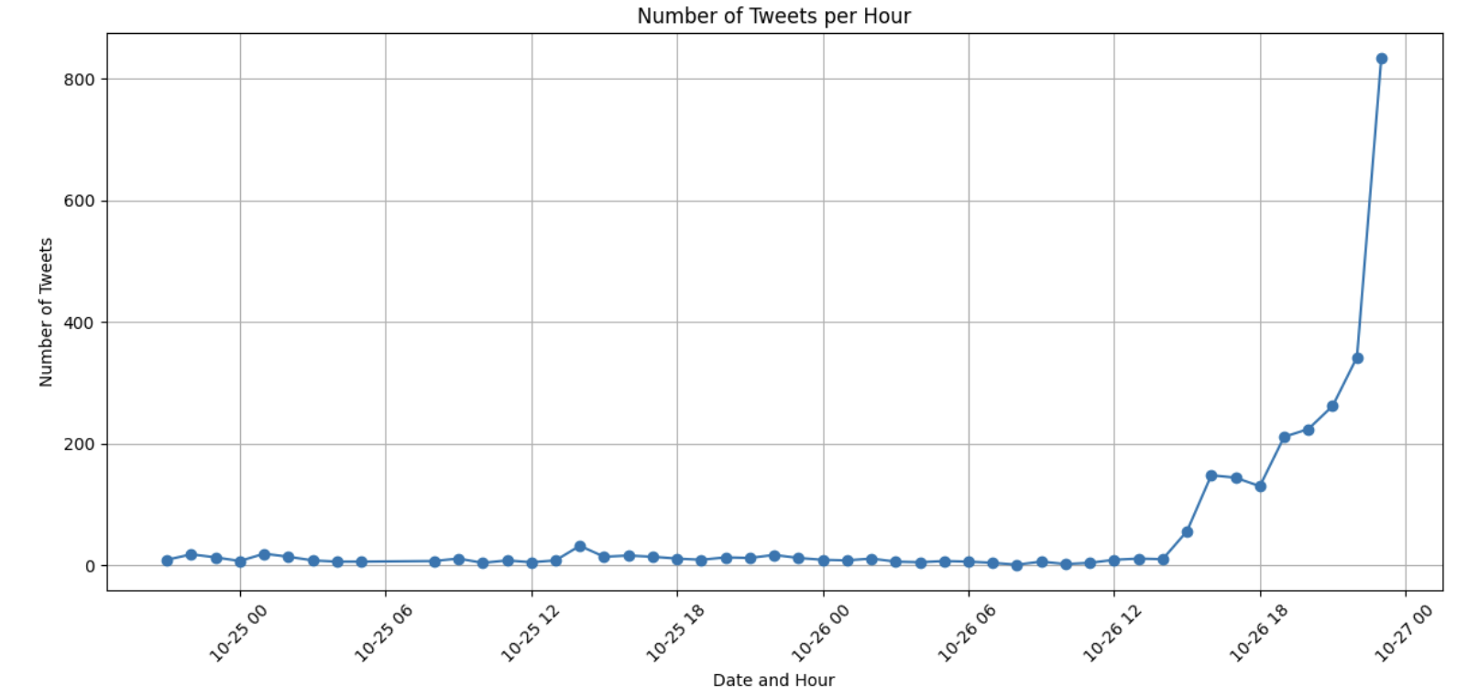
EDA

Slide 9
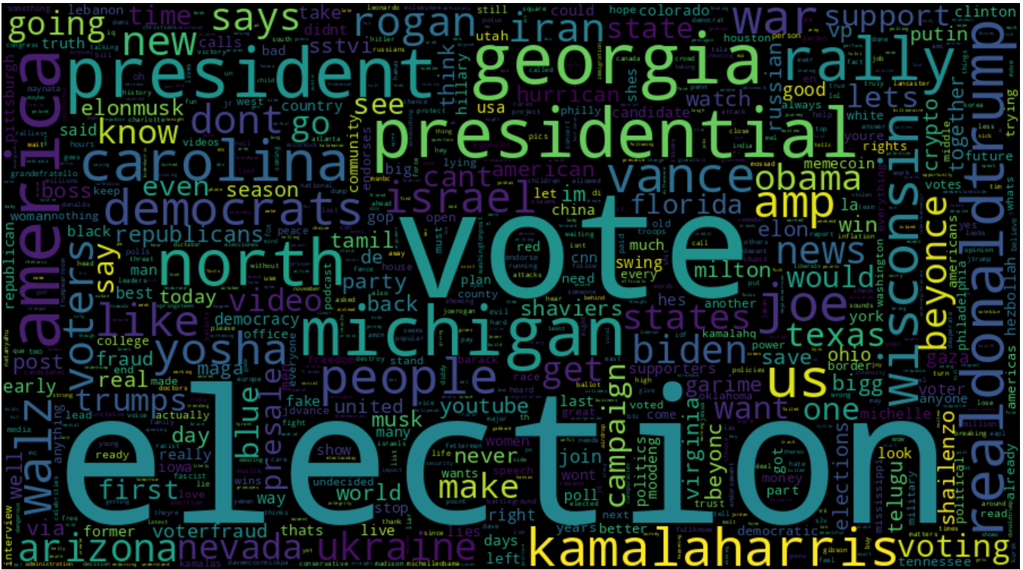
Overall word cloud
Word_freq

Slide 10
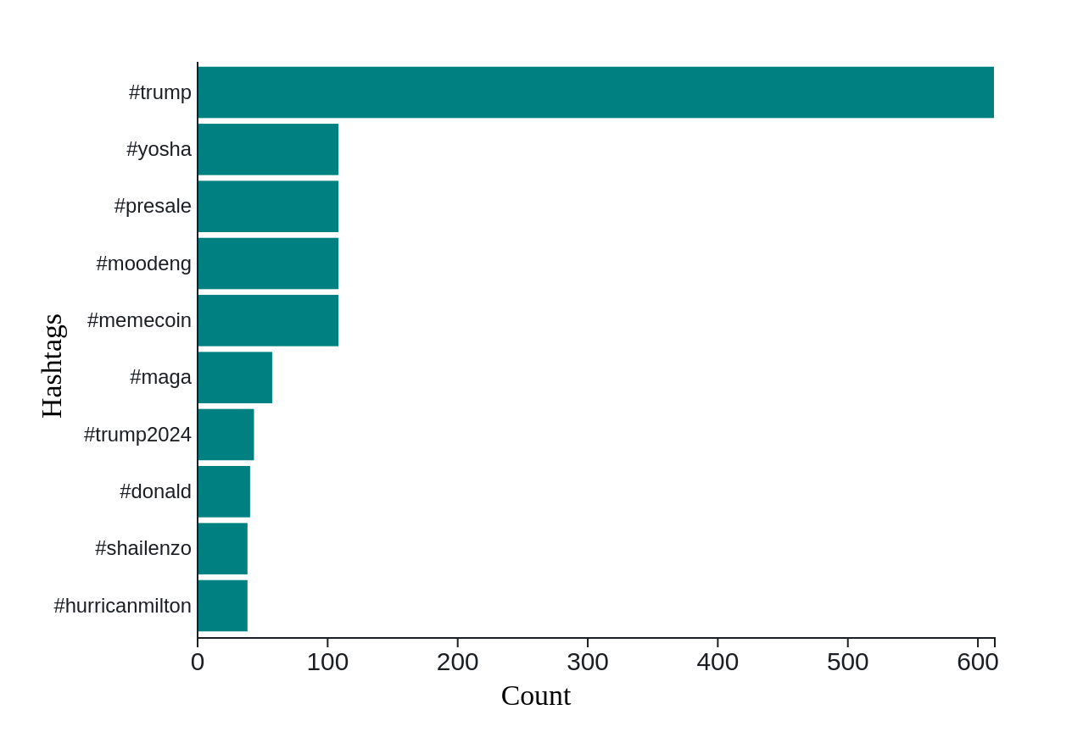
Overall hashtag top10
Notes:
In trump, no mention of kamala -> but other way it’s done

Slide 11
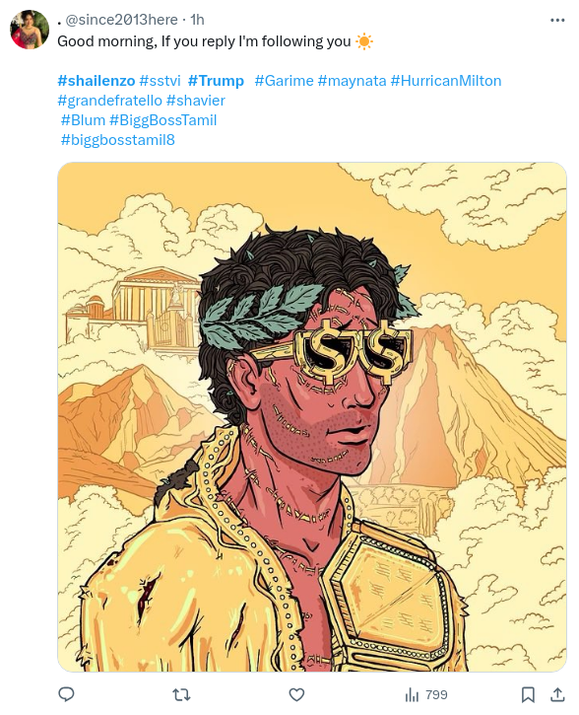
hashtag hijacking
Notes:
https://x.com/ferrenft

Slide 12
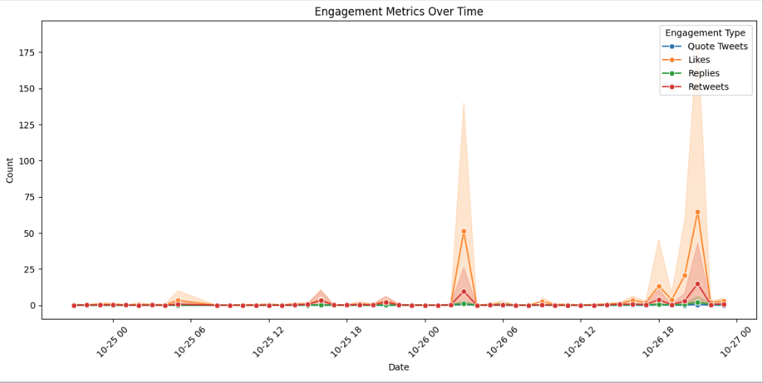
Top engaging posts
993 something has atleast one like or RT
Notes:
JSON of extracting engagement

Slide 14
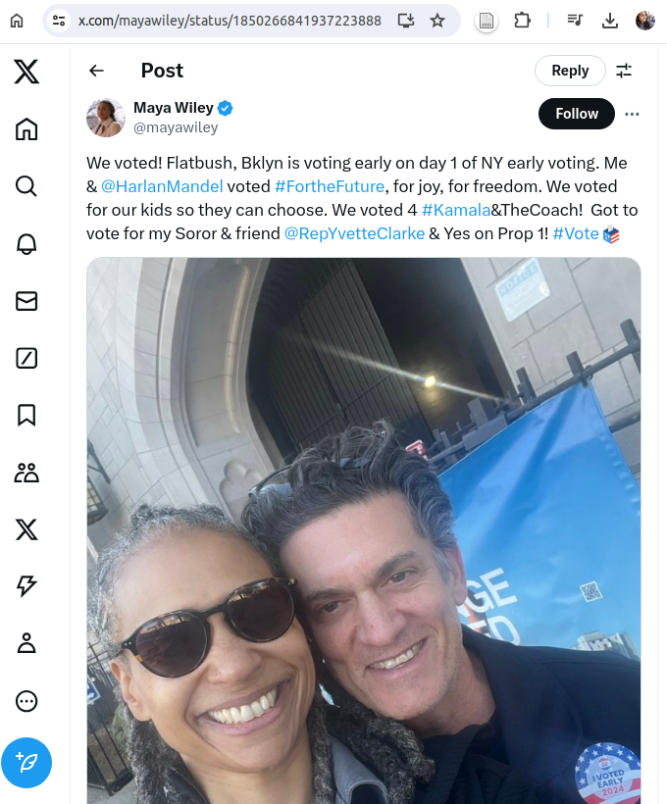
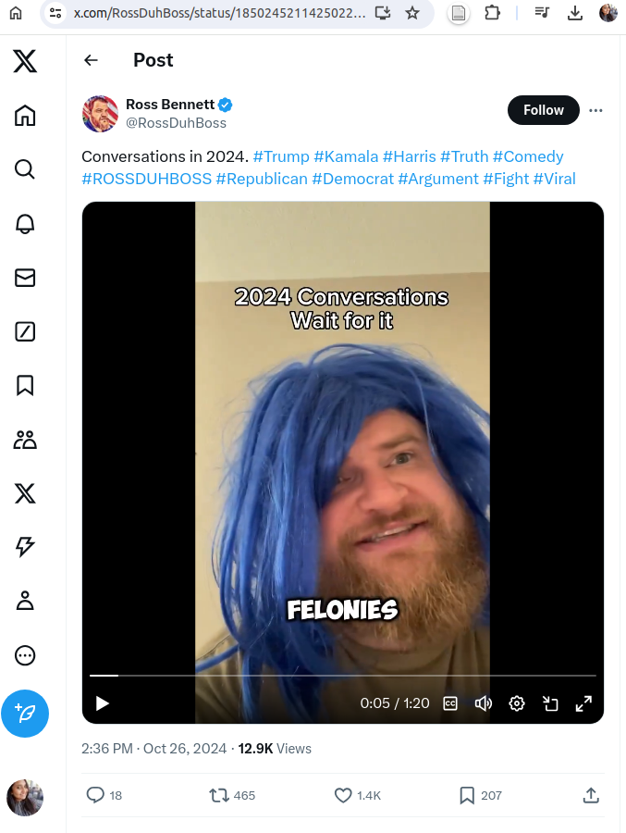
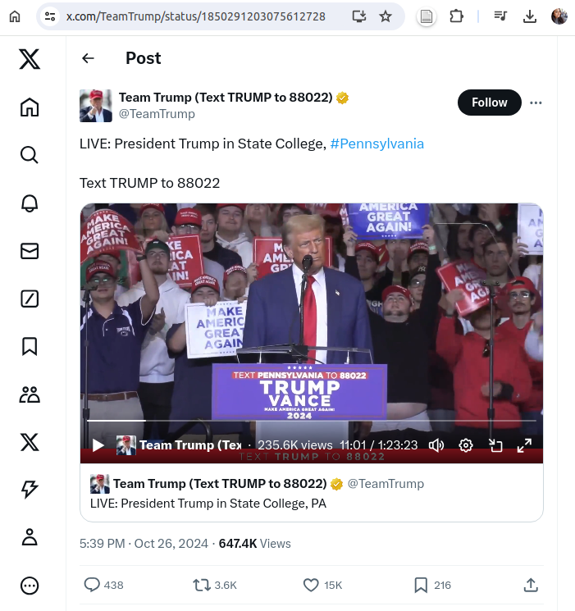
Top most likes: 15,851 https://x.com/TeamTrump/status/1850291203075612728
https://x.com/RossDuhBoss/status/1850245211425022373
Likes: 1433
https://x.com/mayawiley/status/1850266841937223888 Likes: 4270

Slide 15
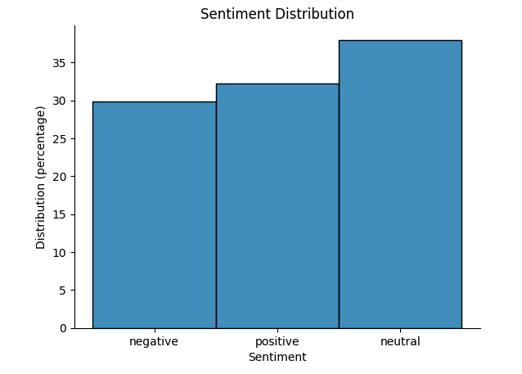
Sentiment -
Sentiment distribution - overall

Slide 16
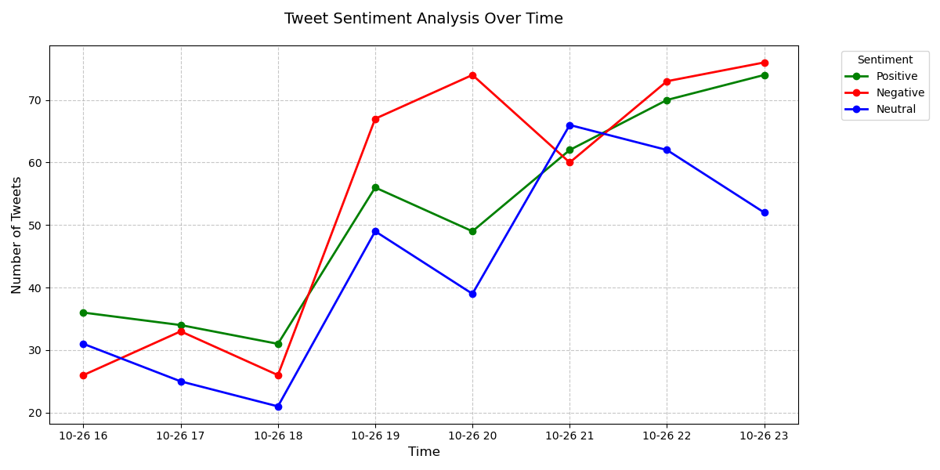
Sentiment for each hashtag - (kamala)

Slide 17
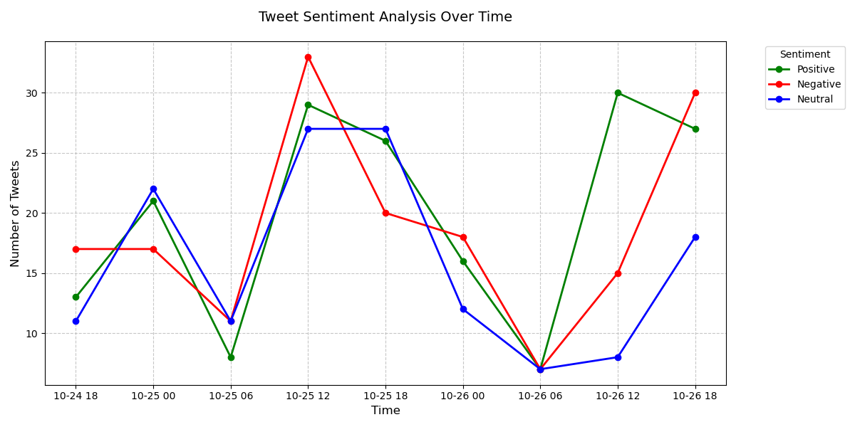
Sentiment for each hashtag - (pres election)
Notes:
Peak in presidential election
At 2:00 PM, October 25, 2024, trending election topics included tight polling in battleground states like Arizona and Wisconsin, rallies from candidates Harris and Trump, and comments from celebrities stirring debate. Election security concerns and international perspectives on a possible Trump victory were also widely discussed.
Both of these major national polls released on October 25th show an extremely close race between Harris and Trump, with the candidates essentially tied. This indicates the 2024 presidential election remains highly competitive heading into the final days of the campaign.

Slide 18
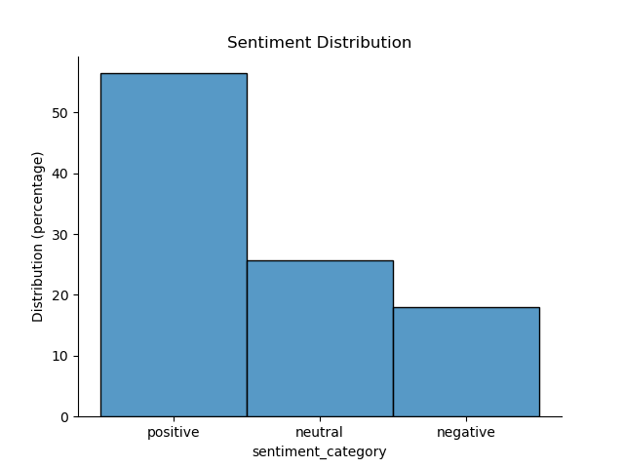
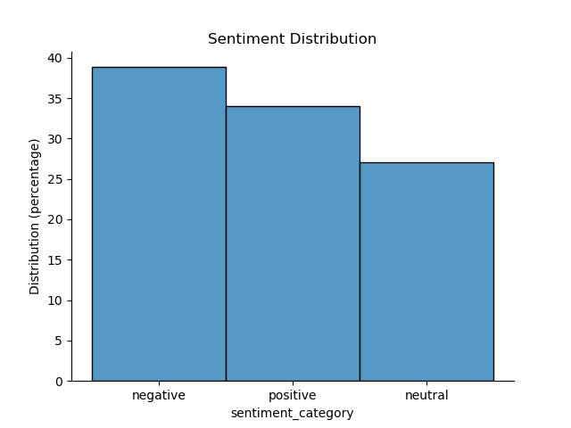
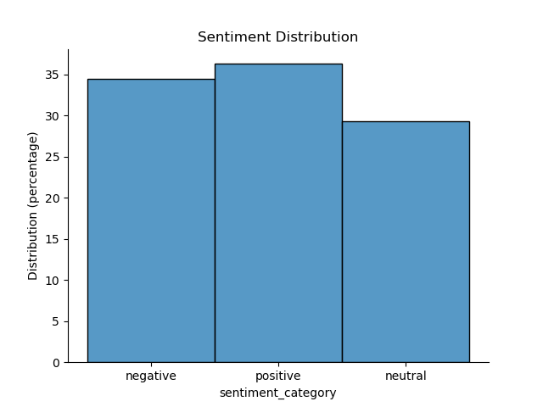
Sentiment for each hashtag - (pres election)
#Donald
#Kamala
#Presidentialelection

Slide 19
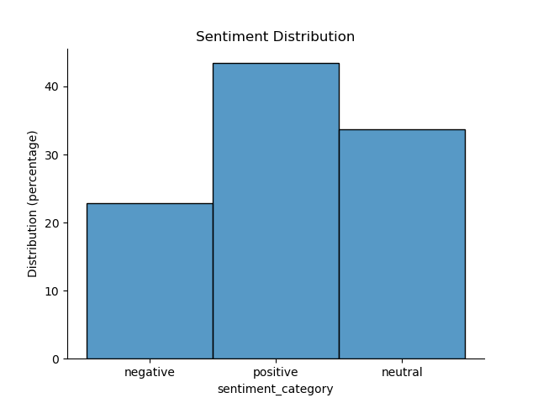
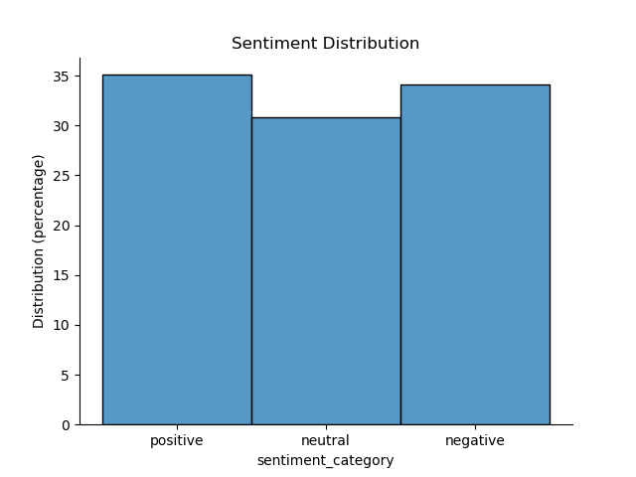
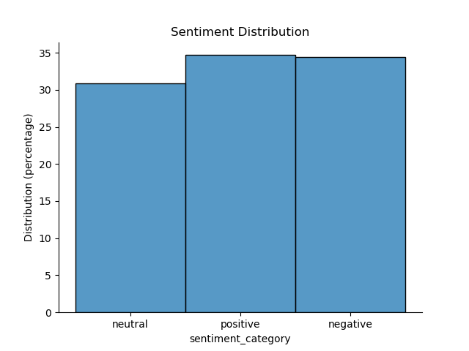
Sentiment for each hashtag - (pres election)
#Trump
#Harris
#Pennsylvania

Slide 20
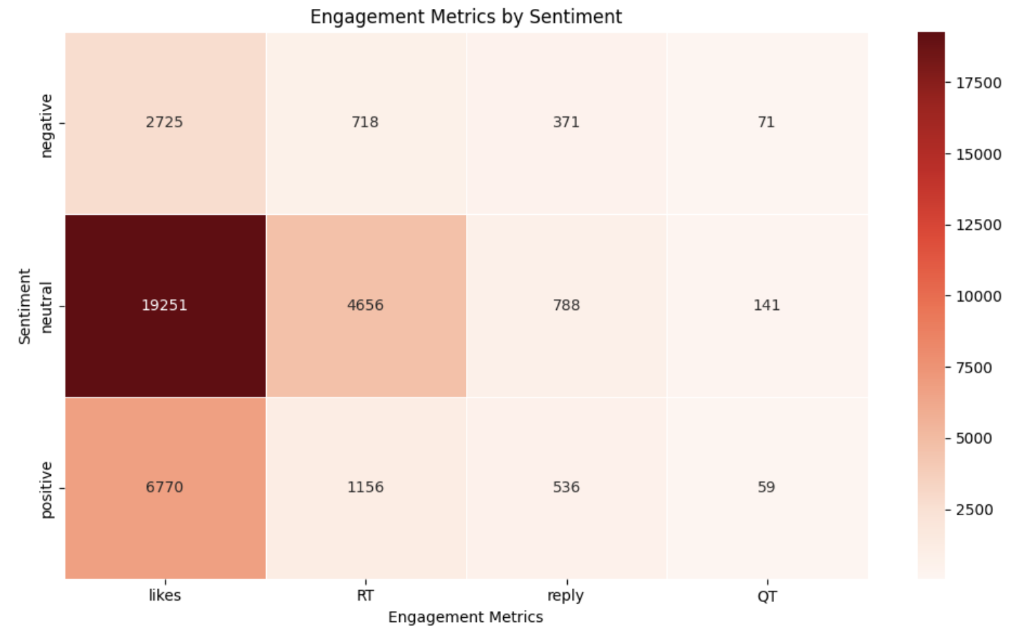
Sentiment vs. Engagement - Kitty
Remove ones without any engagement and try this
Keep ones with atleast one like or RT

Slide 21
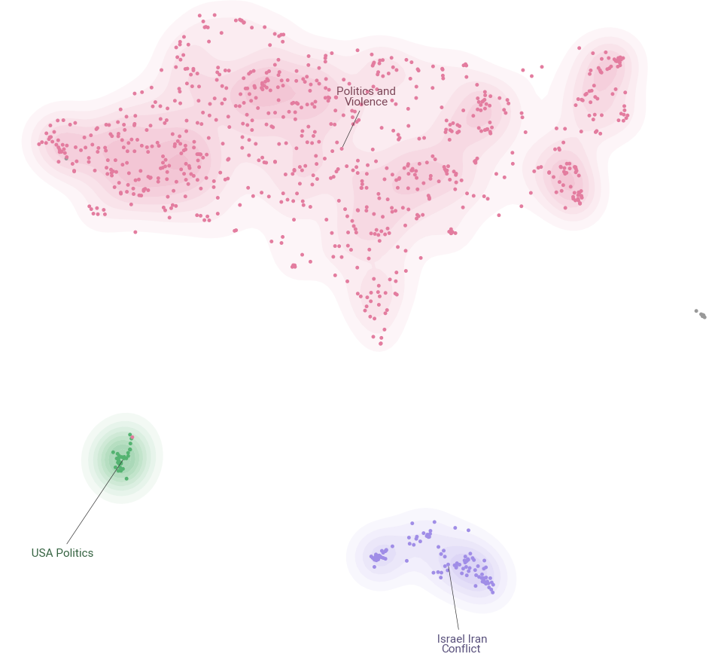
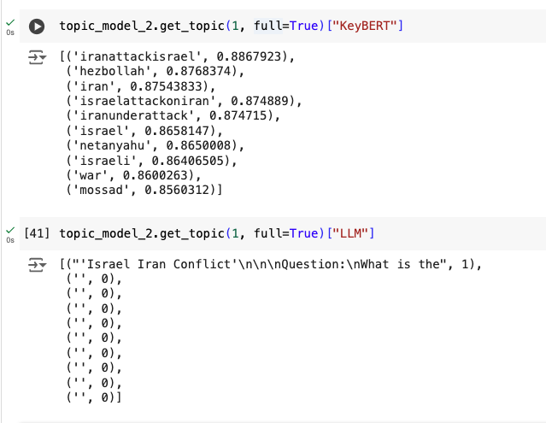
Topic Modeling on Negative Sentiments Tweets

Slide 22
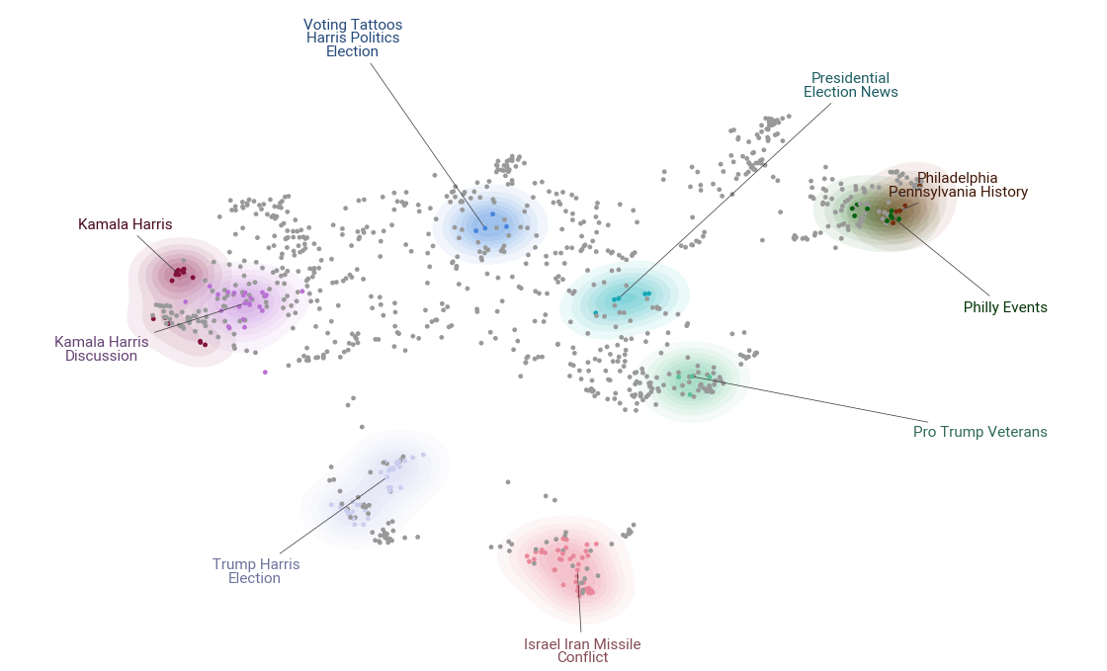
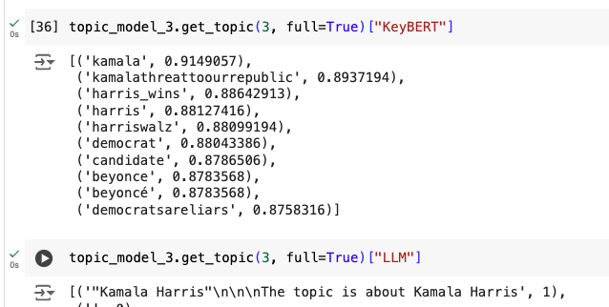
Topic Modeling on Neutral Sentiments Tweets

Slide 23
Conclusion

Slide 24
Backup Slides

Slide 25
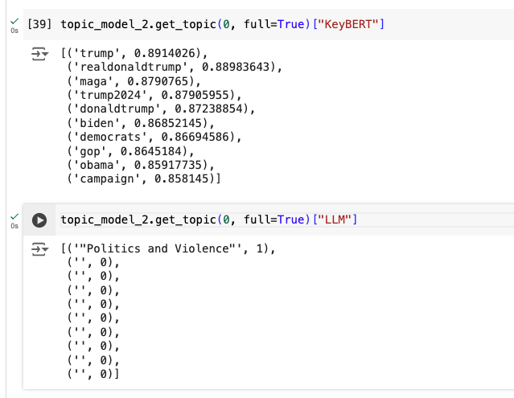
Topic Modeling-Negative

Slide 26
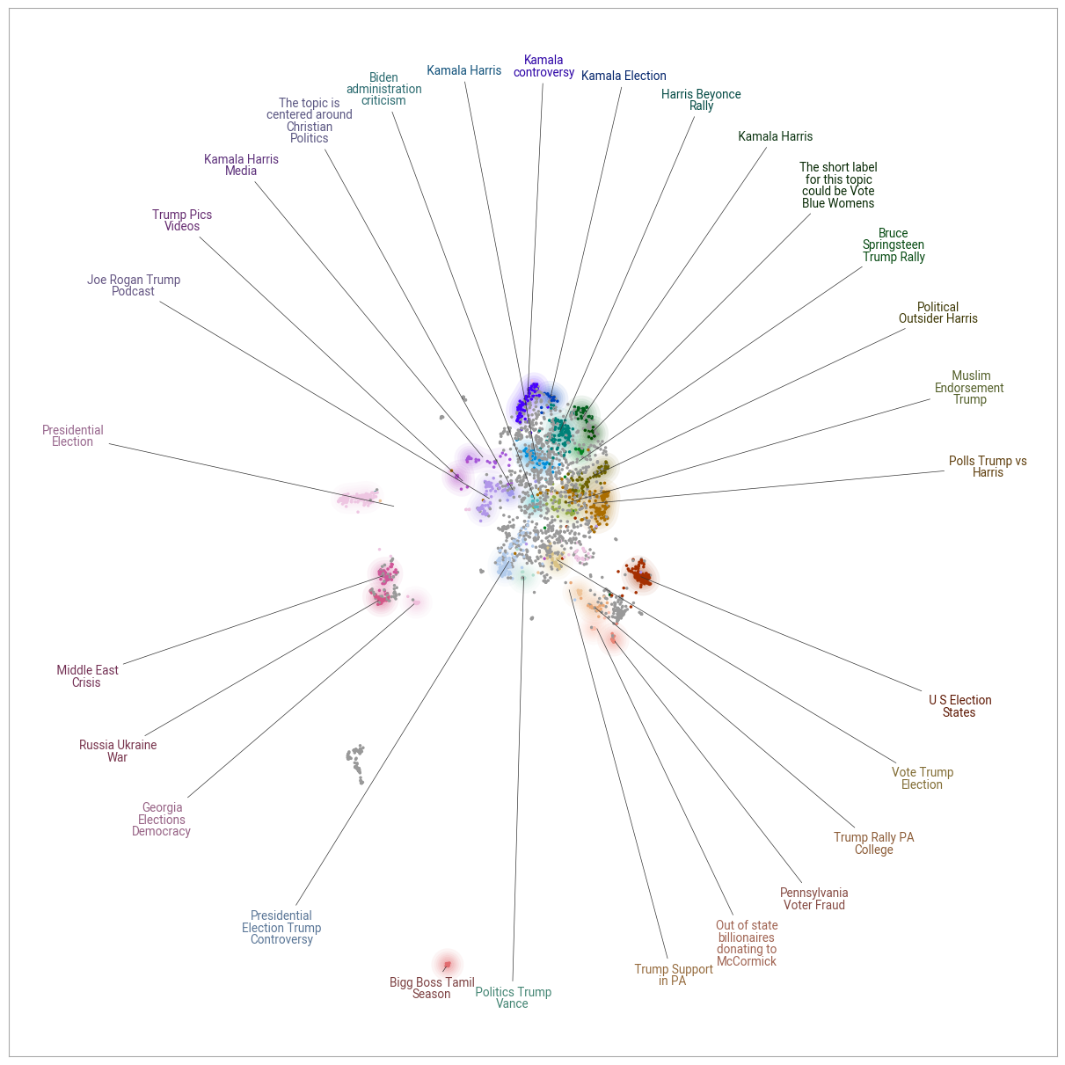
Topic Modelling on Tweets

Slide 27
Examples - Positive, Negative, Neutral

Slide 28
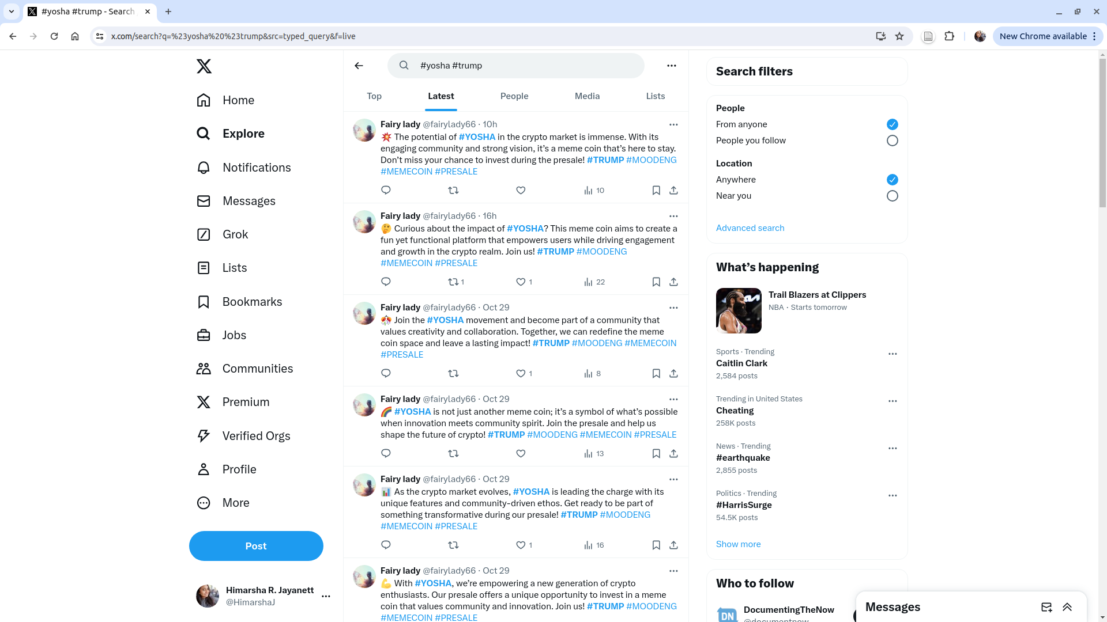
Notes:
https://www.coingecko.com/en/coins/maga

Slide 29
Example - JSON

Slide 30
Methodology
Data Collection
EDA
Analysis

